Slide 1




DEPARTMENT OF ELECTRONICS AND COMMUNICATION ENGINEERING
NETWORK INTRUSION DETECTION
USING XG-BOOST ALGORITHM
Project Members :
GUNASEKARAN - 712220116003
KABIL S - 712220116005
KANISHKAA P -712220116006
MANOJ K - 712220116011
Project Guide:
C. PREETHIBA M.E, /ASP

Slide 2
Abstract
In today’s digital age, cybersecurity threats are growing in complexity, necessitating advanced Network Intrusion Detection Systems (NIDS).
This study explores the use of multiple machine learning algorithms XGBoost, Random Forest, Logistic Regression, and Decision Tree—to classify network traffic as "Attack" or "Non-Attack.“
These models are trained on pre-processed and normalized network data to enhance detection accuracy.
XGBoost offers scalability and effectively handles imbalanced data, while Random Forest and Decision Tree provide strong classification capabilities. Logistic Regression adds simplicity and interpretability.
Together, these models are evaluated to improve the adaptability and performance of NIDS in detecting evolving cyber threats.

Slide 3
Introduction
As cyber threats grow more advanced in today’s hyper-connected world, securing digital networks has become a top priority.
Traditional Network Intrusion Detection Systems (NIDS) often fall short in identifying novel attacks and managing imbalanced datasets.
This research presents a robust, data-driven approach using four powerful machine learning algorithms—XGBoost, Random Forest, Logistic Regression, and Decision Tree—to effectively detect and classify network intrusions.
By extracting and normalizing features from network traffic, these models work together to improve detection accuracy and system responsiveness.
This integrated strategy aims to build a more intelligent, adaptive NIDS capable of defending against modern and evolving cybersecurity threats.

Slide 4
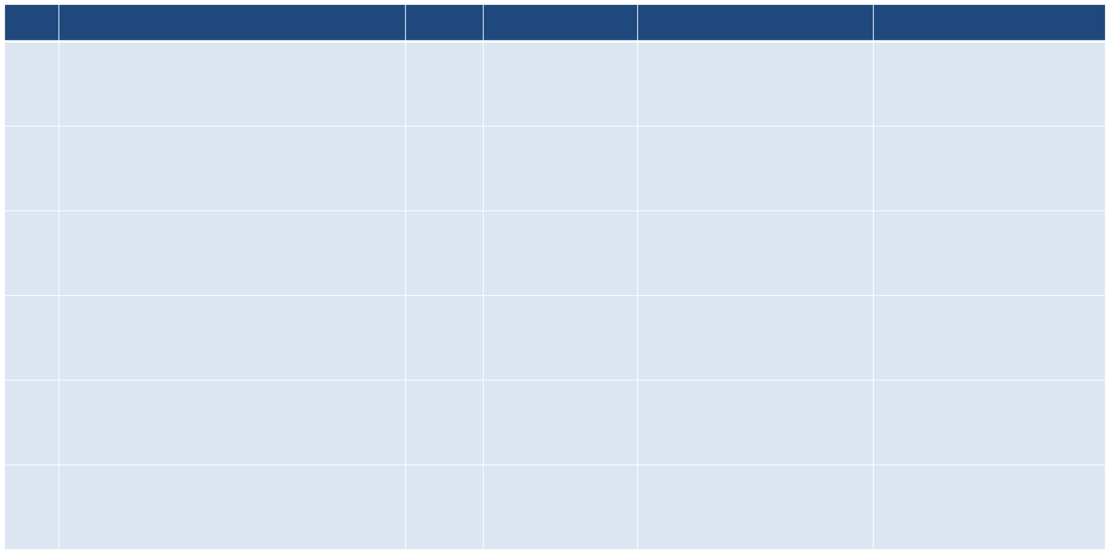
Literature Review
S.No
Title
Year
Journal Name
Techniques Used
Disadvantages
TRANSACTIONS ON INFORMATION FORENSICS AND SECURITY, VOL. 19, 2024
Overfitting
High-computation
Data-quality
1.
TMG-GAN: Generative Adversarial Networks-Based Imbalanced Learning for Network Intrusion Detection
2023
GAN, Deep Neural Networks (DNNs)
AI, Generative Adversarial Networks (GAN),
An Enhanced AI-Based Network Intrusion Detection System Using Generative Adversarial Networks
IEEE Internet of Things Journal (
High training complexity, mode collapse, adversarial vulnerability.
2.
2022
GAN, One-Class Classification, Anomaly Detection.
Imbalanced learning, mode collapse, high computational cost.
3.
Early Detection of Network Intrusions Using a GAN-Based One-Class Classifier
2022
IEEE Access
Network Intrusion Detection Using GAN and ResNet Optimized with Particle Swarm Optimization
GAN, ResNet, Particle Swarm Optimization (PSO), Intrusion Detection
High computational cost, slow convergence, risk of overfitting.
4.
2023
(ICAC3N)
GAN Variations, Intrusion Detection, Adversarial Learning.
Mode collapse, high training complexity, adversarial instability.
5.
Intrusion Detection System Using Generative Adversarial Network (GAN) Variations
2022
Sprin(InCACCT)ger
Exploring the Effectiveness of Synthetic Data in Network Intrusion Detection through XAI
2024 Cyber Awareness and Research Symposium
Synthetic Data, XAI, Machine Learning, Intrusion Detection.
Potential bias, lack of real-world variability, interpretability challenges.
6.
2024

Slide 5
Literature Review
S.No
Title
Year
Journal Name
Techniques Used
Disadvantages
Generating Synthetic Tabular Data for DDoS Detection Using Generative Models | 2023 | (TrustCom) | GANs, Variational Autoencoders (VAEs), Synthetic Data Generation.. | Mode collapse, data bias, limited generalization.
Generating Synthetic Tabular Data for DDoS Detection Using Generative Models | 2023 | (TrustCom) | GANs, Variational Autoencoders (VAEs), Synthetic Data Generation. | Mode collapse, data bias, limited generalization.

Slide 6
EXISTING SYSTEM
Existing Network Intrusion Detection Systems (NIDS) rely on machine learning algorithms like decision trees, random forests, support vector machines, and neural networks to analyze network traffic and detect malicious activities.
These systems operate by collecting and pre-processing network traffic data, extracting relevant features such as packet size, protocol type, and source/destination IP addresses.
The processed data is then used to train a classifier that distinguishes between benign and malicious traffic. While effective, these traditional methods often face challenges such as imbalanced datasets, difficulty in detecting zero-day attacks, and limited adaptability to evolving threats.
These limitations highlight the need for more advanced techniques, such as GANs, to enhance NIDS performance.

Slide 7
DISADVANTAGES
Data Imbalance
Difficulty in Detecting Zero-Day Attacks
Limited Adaptability to Evolving Threats
Feature Engineering Complexity
Scalability Issues

Slide 8
PROPOSED SYSTEM
The proposed Network Intrusion Detection System (NIDS) leverages the XGBoost algorithm to enhance cybersecurity by accurately classifying network traffic as "Attack" or "Non-Attack."
XGBoost effectively handles data imbalance and learns complex attack patterns, improving detection accuracy.
Its gradient boosting approach reduces false positives and enhances anomaly detection, enabling robust, real-time threat identification.
This system offers a proactive and scalable solution to evolving cybersecurity challenges.

Slide 9
ADVANTAGES
High Detection Accuracy
Handles Imbalanced Data
Fast and Scalable
Low False Positive Rate
Adaptability
Proactive Defense

Slide 10
COMPARISON
Model | Accuracy | Precision | Recall | F1-score
Logistic Regression | 76.5% | 0.75 | 0.76 | 0.76
Decision Trees | 74.0% | 0.73 | 0.74 | 0.73
Random Forest | 83.0% | 0.82 | 0.82 | 0.85
XGBoost | 91.5% | 0.84 | 0.86 | 0.85

Slide 11
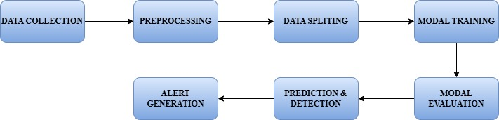
BLOCK DIAGRAM

Slide 12

BLOCK DIAGRAM EXPLANATION
1. Data Collection
The first step involves gathering raw network traffic data from sources like packet capture files (PCAP), network logs, or real-time sensors.
This data includes various attributes such as IP addresses, ports, protocols, and time stamps.
It forms the foundation for building the intrusion detection model.
The quality and diversity of the collected data are critical for the accuracy of the system.
Both normal and malicious traffic should be included for effective classification.

Slide 13
BLOCK DIAGRAM EXPLANATION
2. Data Preprocessing
In this stage, the collected raw data is cleaned and prepared for model training.
Missing values are handled, irrelevant features are removed, and important features like duration, packet count, and flag status are extracted.
Normalization techniques such as Min-Max scaling are applied to ensure consistent data ranges.
Feature engineering may also be performed to enhance model performance.
Proper preprocessing helps in reducing noise and improving detection accuracy.

Slide 14
BLOCK DIAGRAM EXPLANATION
3. Dataset Splitting
After preprocessing, the dataset is divided into training and testing subsets, typically using an 80-20 or 70-30 ratio.
This allows the model to learn patterns from one part of the data and validate them on unseen data. Techniques like SMOTE or undersampling are used to handle class imbalance, where attack data is often much less than normal traffic.
This step ensures the model doesn’t become biased toward the majority class. Balanced datasets lead to more reliable evaluation metrics.

Slide 15
BLOCK DIAGRAM EXPLANATION
4. Model Training
In this core step, machine learning models XGBoost, Random Forest, Logistic Regression, and Decision Tree are trained using the training data.
Each algorithm contributes uniquely: XGBoost is fast and handles imbalanced data well, Random Forest is robust with high accuracy, Decision Tree provides easy interpretation, and Logistic Regression adds simplicity.
Hyperparameter tuning is often applied for optimizing each model.
These trained models learn to differentiate between attack and non-attack traffic patterns.

Slide 16
BLOCK DIAGRAM EXPLANATION
5. Model Evaluation
Trained models are tested using the reserved test data to evaluate their performance.
Key metrics such as accuracy, precision, recall, F1-score, and ROC-AUC are calculated to assess detection quality.
These metrics help identify false positives and false negatives, which are crucial in intrusion detection.
Comparative evaluation across all models helps determine the best-performing algorithm.
A well-evaluated model ensures high reliability in real-time scenarios.

Slide 17
BLOCK DIAGRAM EXPLANATION
6. Prediction & Detection
Once validated, the models are used to classify new, unseen network traffic in real time.
Each data instance is labeled as either "Attack" or "Non-Attack" based on learned patterns.
This step simulates the actual deployment environment of a NIDS.
Fast and accurate classification is essential for quick threat mitigation.
Detection output can be integrated with other security systems for automated responses.

Slide 18
BLOCK DIAGRAM EXPLANATION
7. Alert Generation
When an attack is detected, the system generates alerts for security personnel or automated response systems.
Alerts include relevant details like time, source IP, type of attack, and severity.
These alerts can be logged, visualized in dashboards, or sent as notifications to security operations centers (SOCs).
Early alerts enable quick response, reducing potential damage.
This step closes the loop, allowing for continuous monitoring and threat awareness.

Slide 19
System Requirements
HARDWARE REQUIREMENT:-
PROCESS : INTEL® CORE™ I9-14900K 3.20 GHZ
RAM : 16 GB
HARD DISK : 1 TB
.

Slide 20
System Requirements
SOFTWARE REQUIREMENT:-
FRONT END: HTML,CSS
BACK END : PYTHON
FRAME WORK: FLASK
DATA FRAMEWORK: KAGGLE
HIGH SPEED INTERNET CONNECTION
.

Slide 21
Future Enhancements
Real-time Detection Implement streaming with Kafka or Spark for instant threat alerts.
Deep Learning Integration Better anomaly detection and zero-day threats
Cloud & Scalable Deployment Deploy on AWS/GCP for handling large-scale traffic.
Online Learning Enable models to learn from new data continuously..

Slide 22
CONCLUSION
In conclusion, implementing machine learning algorithms such as XGBoost, Random Forest, Logistic Regression, and Decision Tree significantly enhances the effectiveness of Network Intrusion Detection Systems (NIDS).
These models, trained on well-preprocessed and normalized network data, offer improved accuracy in detecting both known and emerging cyber threats.
XGBoost ensures scalability and handles imbalanced data efficiently, while the others contribute interpretability and robust classification.
By combining their strengths, this multi-model approach delivers a more adaptive and intelligent defense mechanism.
Such advanced systems are crucial for maintaining cybersecurity in an era of increasingly complex and dynamic digital threats.

Slide 23
References
1. EunSeong Seo; JeongEun Kim; Wook Lee; Junhee Seok,"Adversarial Attack of ML-based Intrusion Detection System on In-vehicle System using GAN" 2023 Fourteenth International Conference on Ubiquitous and Future Networks (ICUFN) 10.1109/ICUFN57995.2023.10200297
2. K. Ramkumar; Laith H. Alzubaidi; V Malathy; T. Venkatesh; Kruthika C G,"Intrusion Detection System in Wireless Sensor Networks using Modified Recurrent Neural Network with Long Short-Term Memory" 2024 International Conference on Integrated Circuits and Communication Systems (ICICACS) 10.1109/ICICACS60521.2024.10498333
3. Cheolhee Park; Jonghoon Lee; Youngsoo Kim; Jong-Geun Park; Hyunjin Kim; Dowon Hong,"An Enhanced AI-Based Network Intrusion Detection System Using Generative Adversarial Networks" IEEE Internet of Things Journal ( Volume: 10, Issue: 3, 01 February 2023) 10.1109/JIOT.2022.3211346

Slide 24


